Slide 1
Tracking Down Unmapped Reads
10/27/2021

Slide 2
Overview
The PCR reaction in TempO-Seq has been optimized for robust amplification, ensuring sensitivity and repeatability by efficient amplification from the first cycle.
This works well for most applications, but when there are very few ligated templates, amplification side reactions accumulate and dominate the reaction products. These amplicons don’t align to expected assay content, so their counts remain unmapped.
Side reaction products are dependent on the presence of detector oligos in the assay, and unmapped sequences consist of partial detector oligos.
A particularly common side reaction product consists of a fusion between the PCR primer sequences, essentially an insertless product. This is important because this means that the side reaction is not due to primer dimers, but instead, the side reaction must be templated by some assay product.
The following slides present an hypothesis for the origin of templates that can generate the insertless amplicon.

Slide 3
TempO-Seq Biochemical Steps
1) Contact sample with probe pair
Schematic for one RNA target is shown.
Each target is exposed to a ~1000-fold excess of detector oligos (DOs).
Each test starts with 3 fmol of DOs per target. After digestion and ligation, there should be ~3 amol of DOs per target as amplifiable template.
Each amplification starts with 20 pmol of each primer. In the WT assay, there would be ~60 fmol of amplifiable templates. That means a ~300-fold greater number of primers to templates, sufficient to efficiently amplify all templates from the first cycle for maximum sensitivity and repeatability.
RNA target
+
probe pair with multiple sequences
2) Probes bind RNA target
+
excess probes
3) Add 3’ Exonuclease
protected probes
digested probes
4) Ligate Probe Pairs
ligated probes
5) Amplify
5’ 3’
oligo sequence orientation
amplification

Slide 4
Potential Templates
5’ Forward…CTACACGACGCTCTTCCGATCT 3’
DDO: 5’CTACACGACGCTCTTCCGATCTCTTGCACTAGGCCACTTCCTAGCCT
primer landing site
downstream target seq
primer landing site
upstream anchor seq
5’PHOS-GCAGGCTGCCTATGGATCTCCTGTTCCTGTGGTCGTAGCATCAGCTACTTGCCACTCAGGGCCC 3’:UDO
upstream target seq
3’GGACACCAGCATCGTAGTCGAT… Reverse 5’
Residual partially digested detector oligos may contain primer landing sites, but only if they survive the exo step. This would require 2 things:
1) some cross-hybridization between different detector oligos or some secondary structure within detector oligos that is stable during the exo digestion
2) a protected sequence that can hybridize to at least the 3’ end of one or both primers.
The most common sequence found in unmapped reads is the fusion of the forward and reverse primers, which appears as 5’…GATCTCCTGT…3’. If this sequence is present in detector oligos and can persist into the amplification, the resulting amplicon would be smaller and therefore more efficiently accumulated.
The Whole Transcriptome detector oligos were screened for the sequences in blue and red, as well as their reverse complements and concatemers.

Slide 5
Detector Oligo Mispriming Sites
Of 22,537 detector oligo pairs (45,074 oligos), 5,107 oligos have at least 1 instance of GATCT, AGATC, CCTGT or ACAGG, sequences that could be primer landing sites.
Of these, there are 643 oligos that have at least 2 of these sequences that could support stem-loop structures. These would include GATCT…AGATC, AGATC…GATCT, CCTGT…ACAGG, and ACAGG…CCTGT.
There are 7 oligos that contain fusion sequences:
3 have GATCTCCTGT
2 have AGATCCCTGT
1 has ACAGGTCTAG
1 has GATCTGGACA
So there is opportunity for mispriming if these sequences can persist.

Slide 6
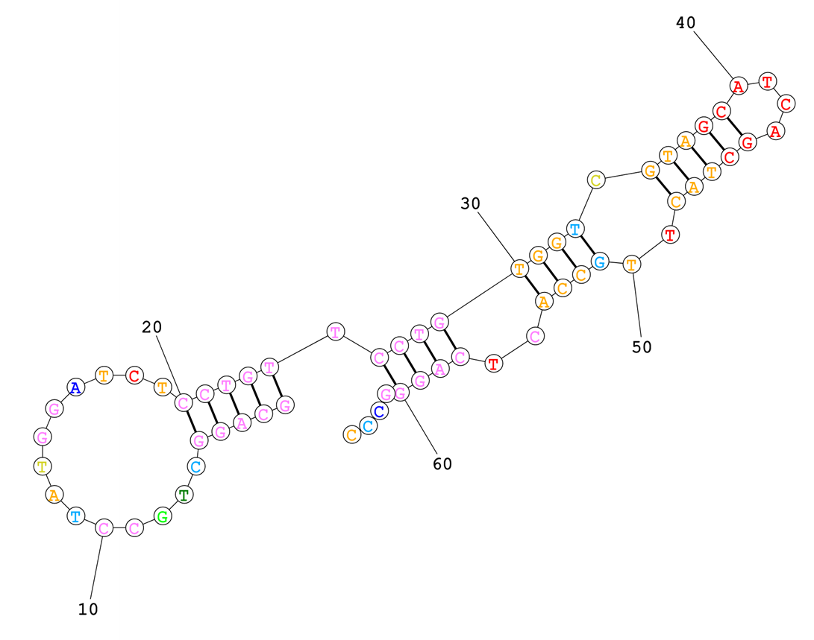
Detector Oligo Structures
Secondary structures are notoriously difficult to model successfully unless the structures are strong. Using a structure calculator available online from an academic specialist, structures were modeled for a few oligos with high frequencies of matching sequences.
In this case, there are 3 double stranded sections that are 3’ of the fusion sequence.
Even if the structure nearest the 3’ end breathes at 37C, the terminal stem loop has a >99% probability.
GATCTCCTGT
5’
3’

Slide 7
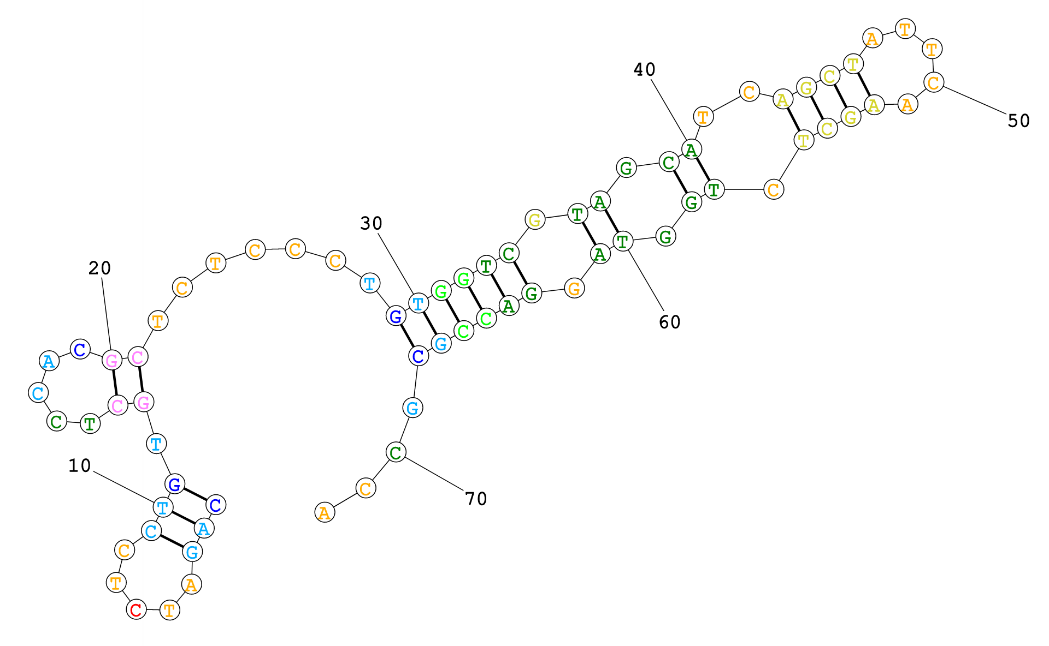
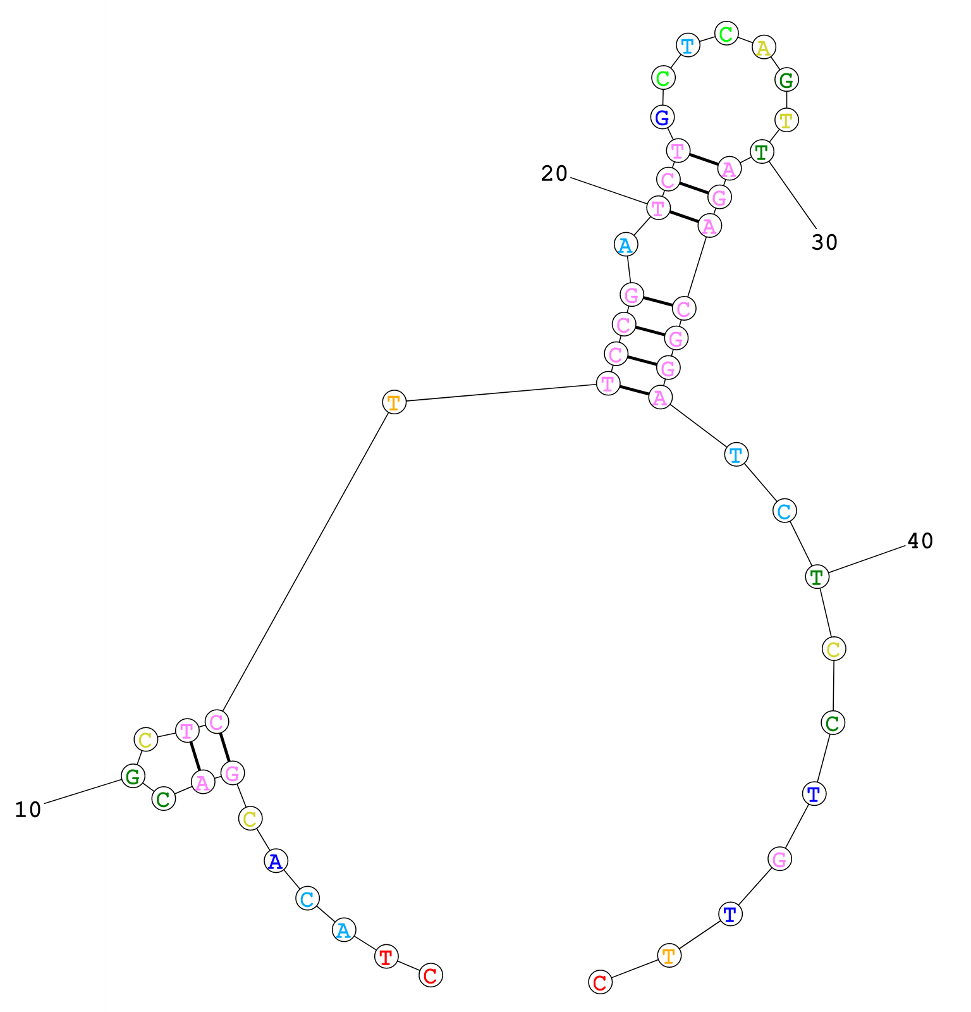
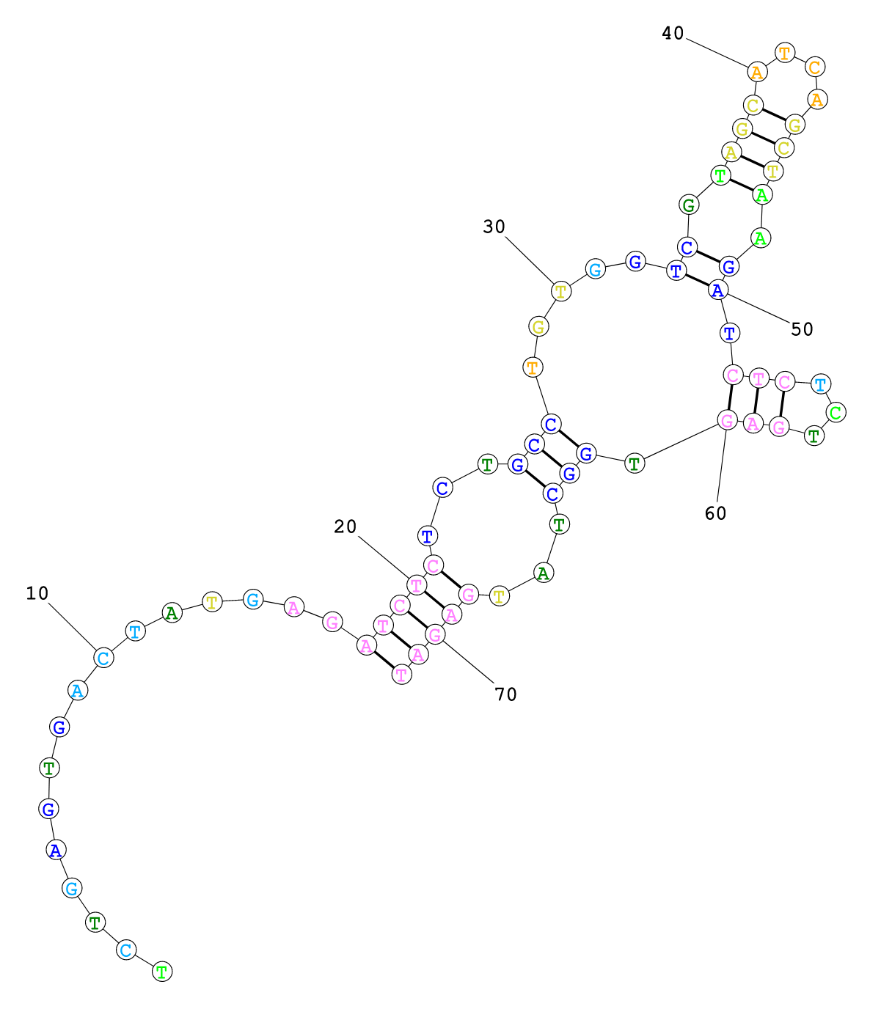
More Structures
GATCT
GATCTCCTGT
GATCT
Different structures are calculated for different oligos. However, there seems to be support for the general idea that structures can protect parts of detector oligos that contain sequences homologous to primer landing sites.

Slide 8
Experimental Tests
We may be able to test these ideas in 2 ways:
If a fusion sequence arises due to multiple mispriming events during amplification, then the population of unmapped sequences might change with cycle number. Milos has tested this.
If a fusion sequence persists after exonuclease digestion, then differences in unmapped reads should reflect the number of homologous sequences in the detector pool. A selection of DOs to test this should arrive today.

Slide 9
Cycle Number Test
Very low depth, but there is no trend in the unmapped sequences. The fraction of the top ten sequences that show the GATCTCCTGT fusion stays the same from 10 cycles through 16 cycles.
This suggests that mispriming that leads to progressively smaller amplicon inserts is unlikely.

Slide 10
Summary
The hypothesis that homologous probe sequences persist after exonuclease digestion and act as template for amplification remains viable.
3 detector oligo pools will be tested at 192-plex each with little or no sample. The pools will differ by the number of homologous 5-mers: high, medium, and zero frequency of 5-mers.

